Slide 1



ARTEMIS HACKATHON 2026
TITLE PAGE
Problem Statement No –4
Problem Statement Title- Care for campus powered by innovation
PS Category- Software
Team Name – Code Vibe

Slide 2

PROBLEM STATEMENT
Describing the problem clearly
Campuses face issues like poor maintenance, delayed
complaint resolution, and lack of proper communication.
Students struggle to report problems easily
No centralized digital system to manage campus care efficiently.
Who faces this problem?
Students
Faculty members
Administrative staff
Campus management authorities

Slide 3
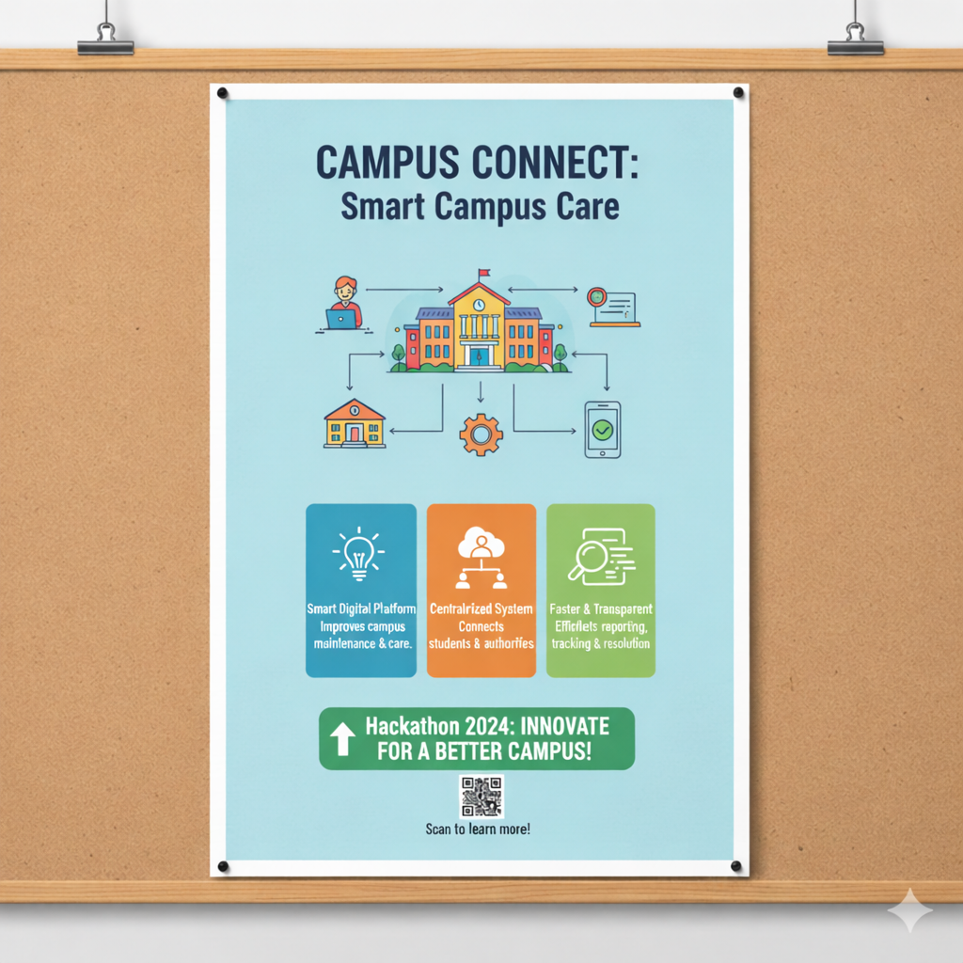

PROPOSED SOLUTION (OUR IDEA)
1️⃣ Our Concept
A smart digital platform designed to improve campus maintenance and care.
It connects students and campus authorities through one centralized system.
Uses technology to make complaint reporting, tracking, and resolution faster and transparent.

Slide 4
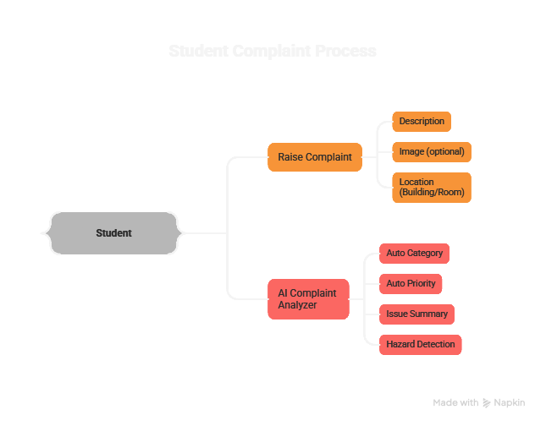
WORKING METHODOLOGY

Slide 5
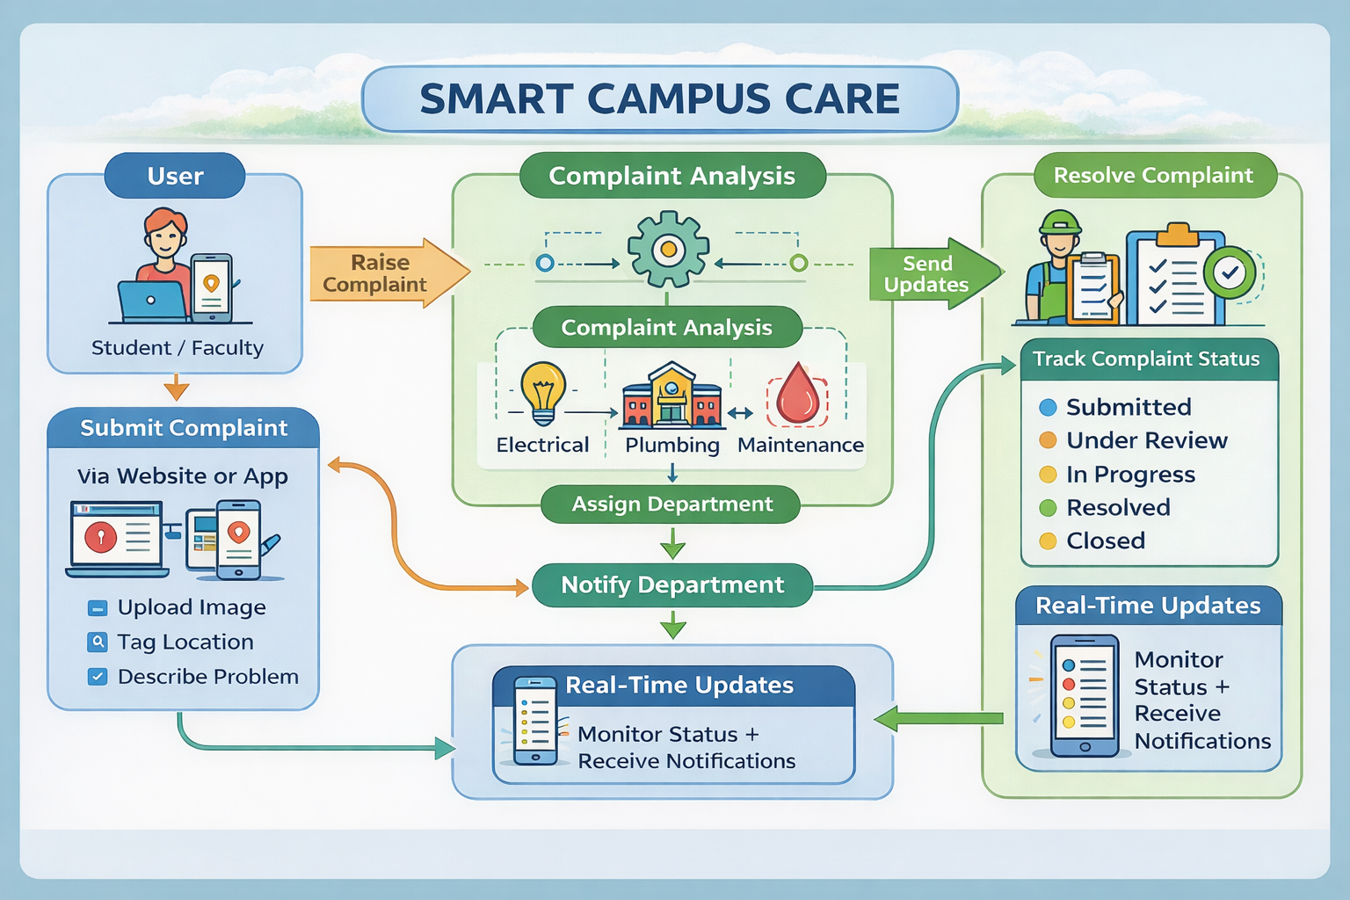
WORKING METHODOLOGY

Slide 6
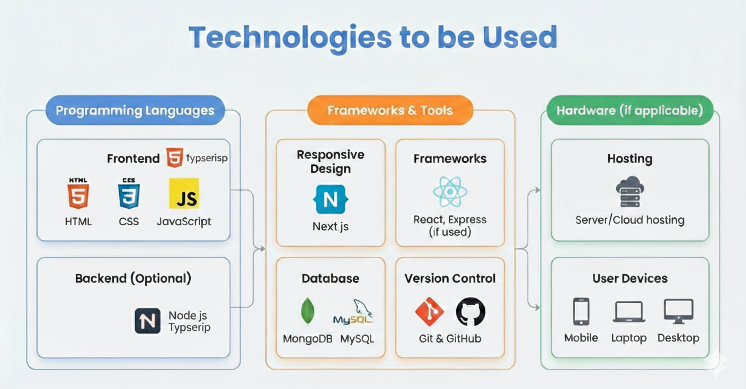
TECHNICAL APPROACH

Slide 7
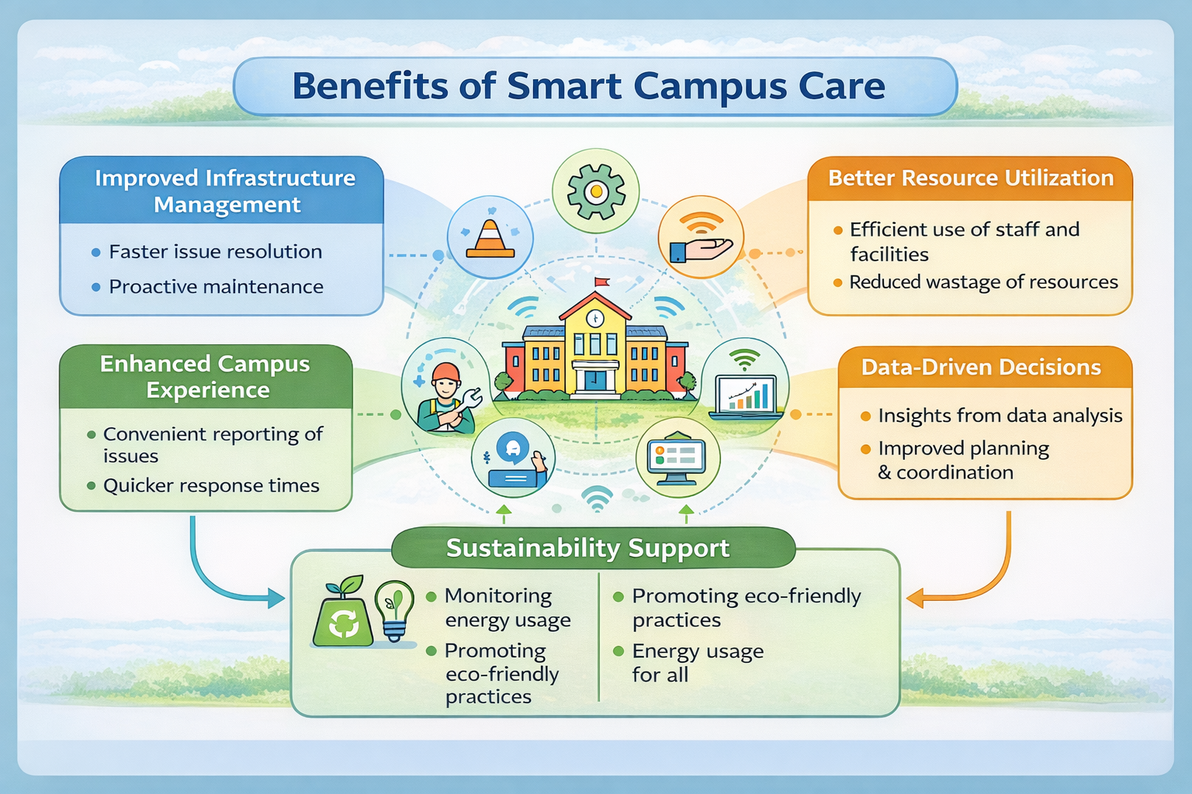
IMPACT AND BENEFITS

Slide 8
CHALLENGES & RISKS
⚠️ CHALLENGES & RISKS
Resistance to adopting new digital systems
Low user participation in the beginning
Data security and privacy risks
Technical issues (bugs, server downtime)
Delay in action from concerned departments
System misuse or fake complaints

Slide 9
FUTURE SCOPE
🚀
Mobile application version for easier access
AI-based issue categorization and priority detection
Integration with IoT sensors (smart dustbins, water monitoring, etc.)
Real-time notification system (SMS/Email alerts)
Analytics dashboard for data-driven decision making
Expansion to Smart City and other institutions

Slide 10
BUSINESS MODEL / PROFIT STRATEGY
💼 BUSINESS MODEL / PROFIT STRATEGY
🔹 Subscription Model
Colleges pay a yearly/monthly subscription fee to use the platform.
🔹 Institutional Licensing
One-time licensing fee for full system deployment in campuses.
🔹 Customization Services
Additional charges for custom features and integrations.
🔹 Maintenance & Support Plans
Paid technical support and system maintenance packages.
🔹 Expansion to Smart Cities
Partner with government bodies for larger-scale implementation.

Slide 11
RESEARCH AND REFERENCES
📖 Research Details & Reference Links
Real-Time Smart Complaint System in Campus (Journal Article) 📄 Musawarman et al., “Real-Time Smart System for Complaint Information System in Campus.” Journal of Information Technology and Its Utilization. ➤ Link: https://doi.org/10.56873/jitu.7.1.5151
Smart Campus Communication System 📄 M.R. Kruthika et al., A Smart Campus Communication System — International Journal of Computer Sciences and Engineering. ➤ Article: ijcseonline.org (search title)
DigiCampus: Smart Campus Management 📄 Rao et al., DigiCampus: Smart Campus Management — IJARESM (2025). ➤ Link/DOI: https://doi.org/10.56025/IJARESM.2025.1303253268

